Slide 1

I’m Just a Bill
By: Anuska Mondal, Wesley Barnes, Rich McKnight, Yash Rawat

Slide 2
01.
Problem
So many bills are introduced, but only a fraction of them are passed. The complexity of the process and the high volume make it much too difficult for lawmakers, lobbyists, advocacy groups, and just regular citizens effectively predict or track the success of a bill.
Notes:
In legislative bodies worldwide, thousands of bills are introduced annually, but only a fraction are passed due to the complexity of political, economic, and social factors influencing their outcomes. This high volume and complexity make it difficult for lawmakers, lobbyists, and advocacy groups to efficiently track and predict which bills are likely to succeed. Given the dynamic nature of the legislative environment and the limited resources of stakeholders, there is a clear need for a more sophisticated, data-driven tool that can provide accurate predictions, optimize resource allocation, and adapt to changing conditions in real time. This sets the stage for the development of a machine learning model designed to predict the probability of bill passage based on relevant features like bill summaries, jurisdiction, and policy areas.

Slide 3
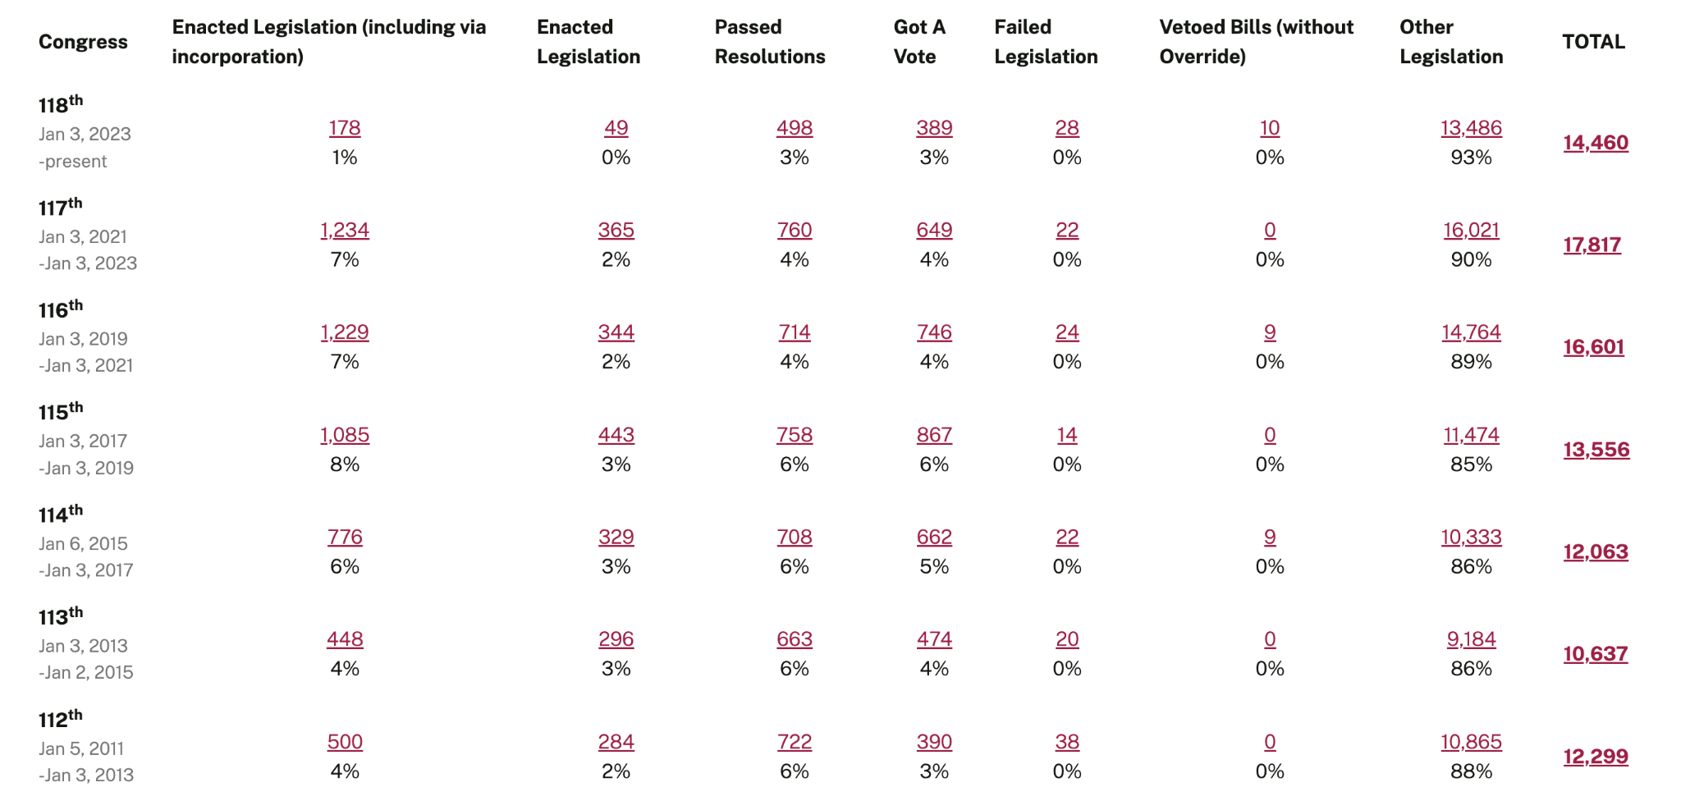
Counts of bills and resolutions.
Notes:
https://www.govtrack.us/congress/bills/statistics

Slide 4
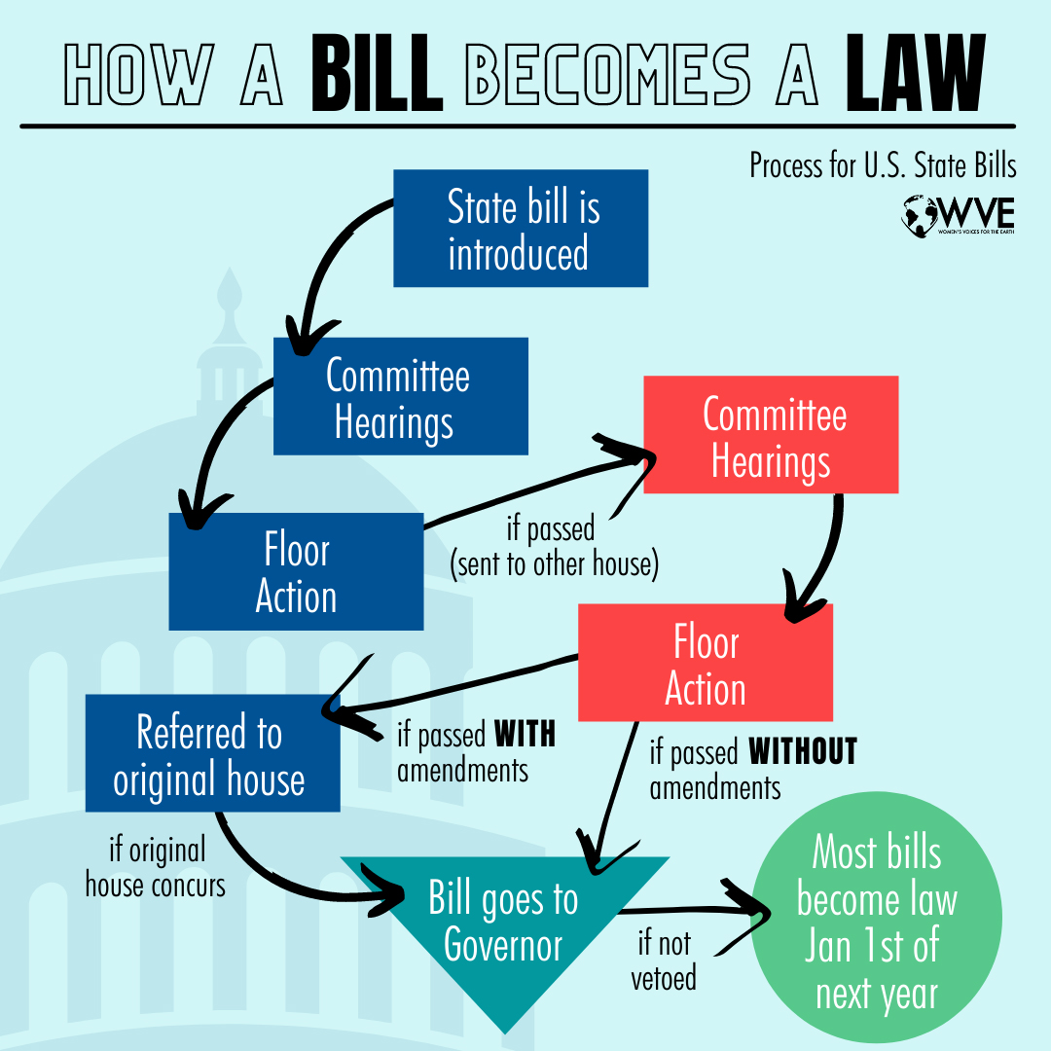
This process on the left is the simplified version of a more complex and longer process with tons of hurdles. For our purposes, we will have to simplify even more and focus on specific stages in order for analysis.

Slide 5
02.
Data
First, we have to find data on bills proposed and make it usable

Slide 6


Data Gathering
Additional web-scraping for:
election Information
makeup of Congress
Notes:
Combination of congress.gov and propublica, and other information on make up of congress, whether the previous election was a midterm election, party of the president and the popular and electoral votes of the previous presidential election.
Propublica had full data sets of all of the bills, but there were some data quality issues that we needed to fix
Pulling all of that data from congress.gov would have been challenging because of API throttling
Some data issues we had to deal with:
Getting the right political party for sponsors and cosponsors
Mapping actions to bill status
we covered the 97th through the 116th congress 1981-2020

Slide 7
Initial Variables of Interest
Actions
Title
Summary
Congress Number
Policy Area
Originating Chambers
Subjects
Sponsors & Cosponsors

Slide 8
Finding the Target
The status of a bill was determined by Actions.
We choose to use only T1_2 and T2_3.
Status 0: Introduced
Status 1: Accepted by Committee
Status 2: Considered by Floor
Status 3: Sent to the President
Status 4: Became Law
T1_2: Status 1 → Status 2
T2_3: Status 2 → Status 3
T0_1: Status 0 → Status 1
T1_2: Status 1 → Status 2
T2_3: Status 2 → Status 3
T3_4: Status 3 → Status 4
Actions
Notes:
177K -> 2 sizing

Slide 9
03.
EDA
What did we find initially?

Slide 10
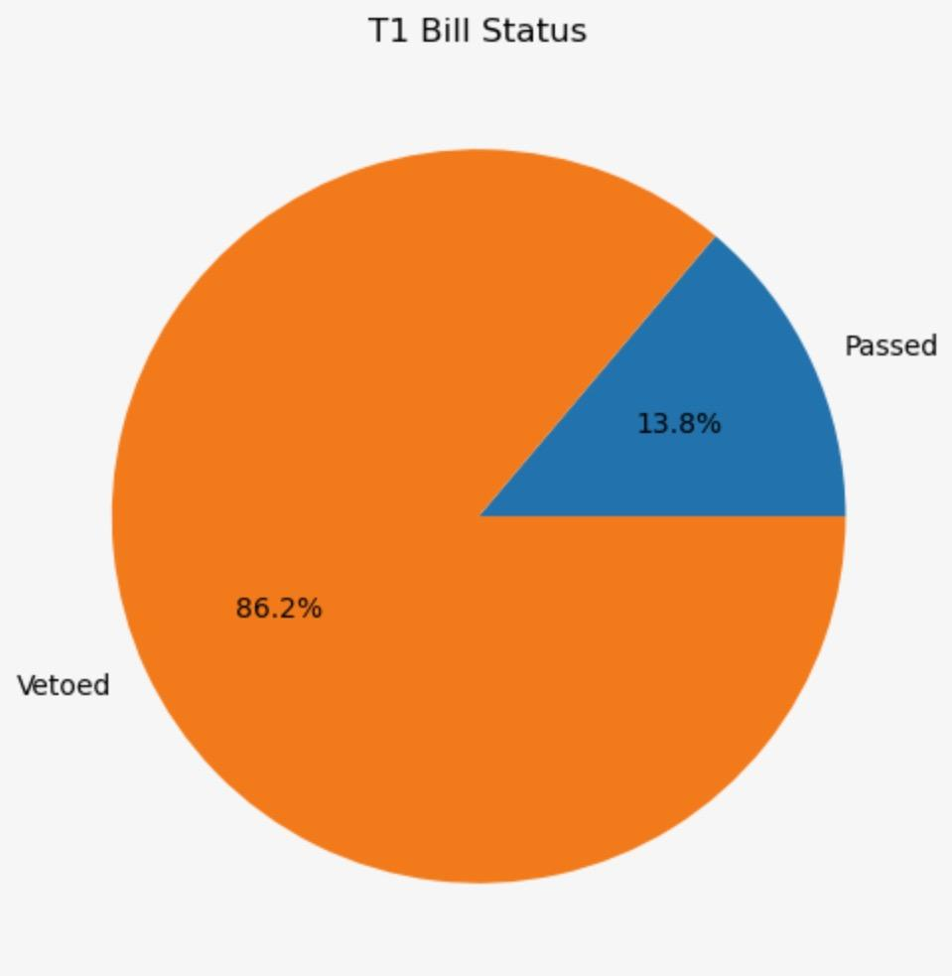
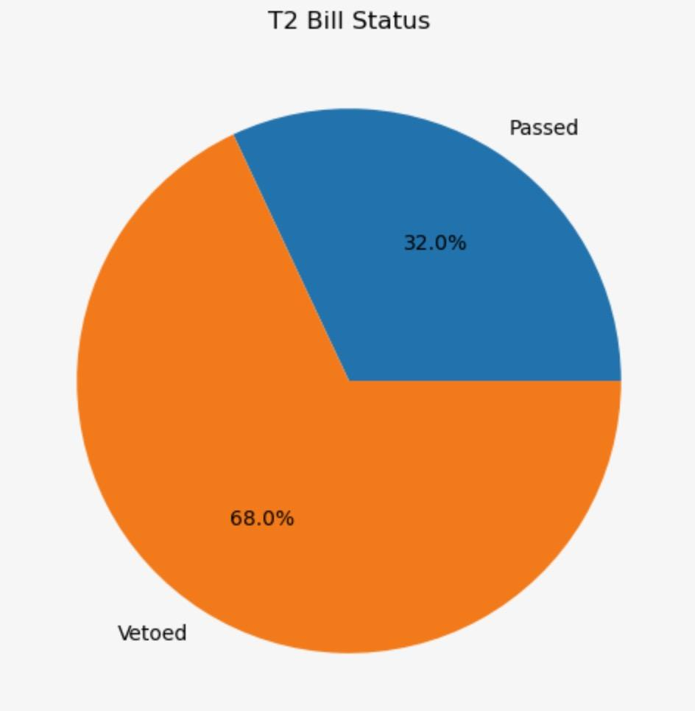
First, class imbalance in target
Approach: Class Weights
Committee Consideration
Floor Consideration

Slide 11
04.
Modeling
Let’s create model!

Slide 12
Logistic Approach - Partisan Influences
Results
Analyzing the effect of:
Bill Sponsorship
Political Landscape
Overall Accuracy: 61%
Accuracy by Policy Areas
Science, technology, communications: 60%
Health: 60%
Crime and law enforcement: 55%
Economics and public finance: 76%
Commemorations: 75%
Energy: 71%

Slide 13
LSTM Approach - Textual
Final Model: Sentence Transformation Model with LSTM - Summary Only
Model Parameters
Epochs: 20
Split: 80/20

Slide 14
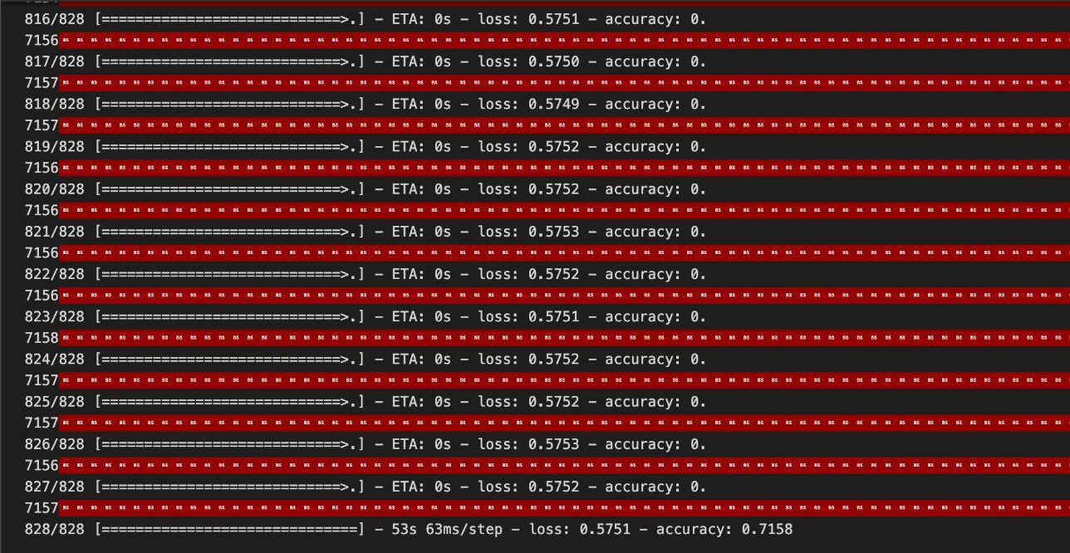
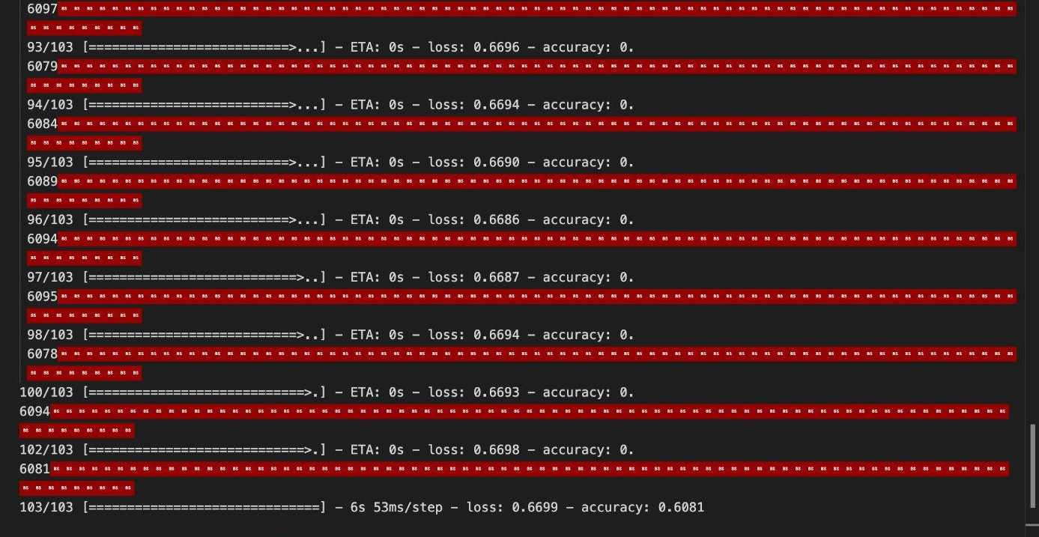
LSTM Approach - Textual
Accuracy for T1 Model: ~72%
Accuracy for T2 Model: ~61%

Slide 15
05.
So What?
Let’s apply this!

Slide 16
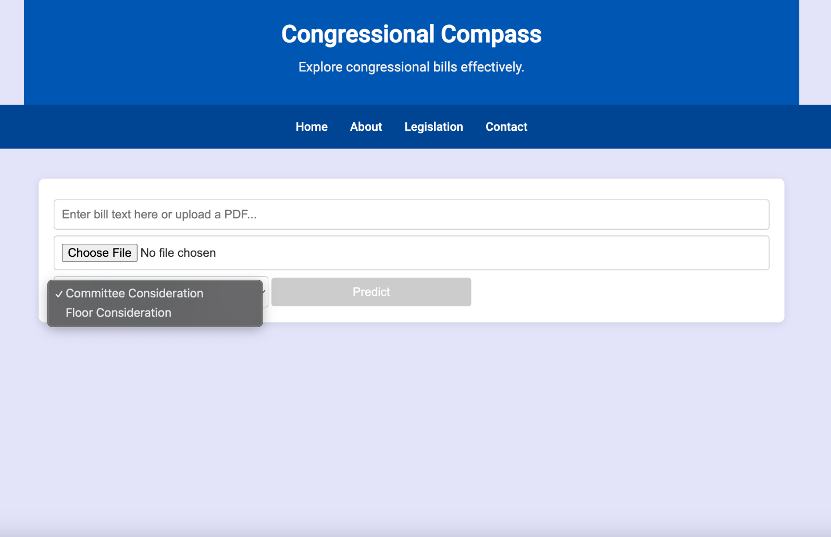
Application
The main point of our project was to create a tool for lawmakers, advocacy groups, lobbyists, and the regular citizen to see how far a bill would get. Through this site, they can!

Slide 17
Thank you!
Do you have any questions?

